Slide 1

DEP INTERNSHIP TASK 1:
Submitted by: HASAN AHMAD KHAN

Slide 2
Comprehensive Network Security Audit for TechCorp
Network security audit of TechCorp by including TCP port scanning, a critical step in identifying network vulnerabilities. Using tools like Nmap, this process will allow us to discover active devices and assess the state of their open ports, which might reveal potential security weaknesses and OpenVAS for vulnerability assessment.

Slide 3

Part 1: TCP Scanning with Nmap
We begin by conducting a TCP scan using Nmap to discover active hosts, open ports, and services running on a network. In this example, we will target the subnet 192.168.1.0/24.
Step 1.1: Host Discovery (Ping Sweep)
Before scanning the ports, we identify which hosts in the subnet are live. This will help us focus on the active devices rather than scanning the entire subnet.

Slide 4
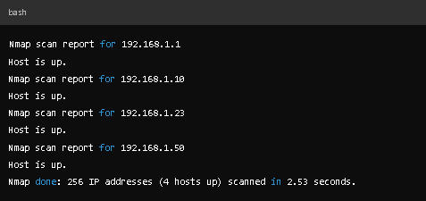
Stimulated results:
We identify four live hosts:
192.168.1.1 (Gateway/Router)
192.168.1.10 (Windows Server)
192.168.1.23 (Web Server)
192.168.1.50 (Application Server)

Slide 5

Step 1.2: TCP Port Scanning
Now that we know which hosts are active, we conduct a TCP port scan on those hosts to discover which services are running on specific ports.

Slide 6
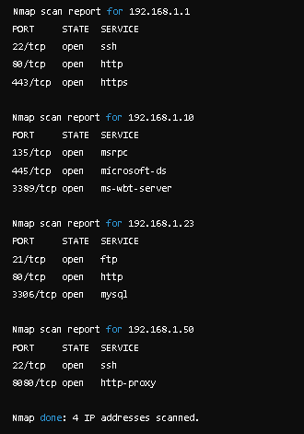
Stimulated Results:

Slide 7

Part 2: Vulnerability Assessment with OpenVAS:
Once the TCP scan identifies open ports and services, we move to the vulnerability assessment using OPENVAS to identify potential security flaws in those services.
STEP 2.1:
Update vulnerability feed on OpenVAS: It’s important to ensure your OPENVAS feeds are up to date:
Access OPENVAS Web Interface: Once OPENVAS is configured, access its web interface to create a new vulnerability scan task.

Slide 8
Step 2.2: Configuring OPENVAS Scan Task
1. Create a New Task::
-In the Tasks section of the web interface, create a new scan task.
-Set the target IP addresses as the ones identified in the Nmap scan (e.g., 192.168.1.1, 192.168.1.10, 192.168.1.23, 192.168.1.50).
2. Start scanning:
Once the task is created, start the scan and wait for the results.
-

Slide 9
Step 2.3: Analyzing OpenVAS results:
Once the scan is complete, OPENVAS generates a detailed report, outlining vulnerabilities, their severity, and recommended remediation steps. Let’s simulate the results for each host based on the open services identified during the TCP scan.

Slide 10
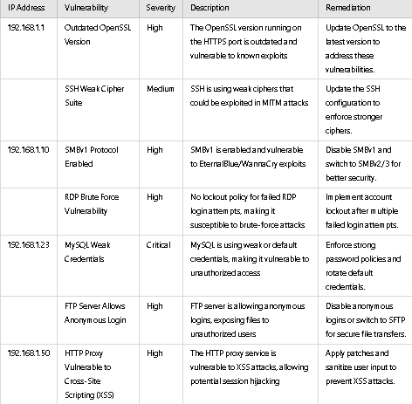
Stimulated OpenVAS results:

Slide 11
Part 3: Reporting and remediation:
Critical findings:
-192.168.1.1: Outdated OpenSSL and weak SSH cipher suites could expose the gateway to potential attacks.
-192.168.1.10: SMBv1 and RDP brute-force vulnerabilities need immediate action due to the high likelihood of exploits.
-192.168.1.23: Weak credentials and anonymous FTP access could lead to unauthorized data access or exposure.
192.168.1.50: XSS vulnerabilities in the HTTP proxy service could allow attackers to hijack sessions and steal sensitive data.

Slide 12
Remediation steps:
1. Update and Patch: Ensure that all vulnerable services (e.g., OpenSSL, MySQL, and SMB)
are updated to the latest secure versions.
2. Harden SSH and RDP: Implement stronger authentication methods, disable weak cipher suites, and enforce brute-force protection mechanisms for RDP.
3. Improve Password Policies: Enforce strong passwords for MySQL and other services, and rotate credentials regularly.
4. FTP to SFTP Migration: Replace the insecure FTP service with an encrypted alternative like SFTP to prevent unauthorized data exposure.
5. Sanitize Proxy Inputs: Address the XSS vulnerability in the HTTP proxy by applying security patches and sanitizing user inputs.

Slide 13
Conclusion:
By applying these steps to TechCorp’s network, a comprehensive audit revealed critical vulnerabilities, policy weaknesses, and gaps in employee training. The actionable recommendations focus on immediate patching, securing access controls, and ensuring ongoing compliance with security standards.
Using these combined techniques—scanning, auditing policies, reviewing configurations—TechCorp can significantly enhance its defenses against external and internal threats, creating a more resilient network infrastructure.

